Slide 1

Confident Spatial Analysis
Thu 3rd March, 9:30am – 4pm
Dr Nick Bearman
@nickbearmanuk
Department of Geography and Planning

Slide 2


Confident Spatial Analysis
Wed 15 Feb 2017
10:00am – 4:00pm
Dr Nick Bearman
@nickbearmanuk

Slide 3
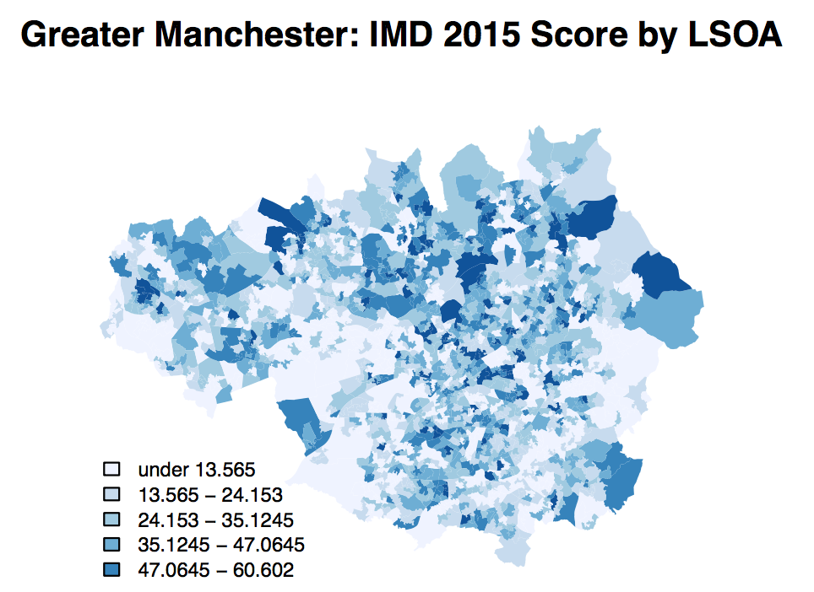
What will you get from the course?
Using a range of GIS software to perform a range of spatial analysis
RStudio and GeoDa
Develop your confidence in using RStudio
Data handling
Scripts
Functions

Slide 4
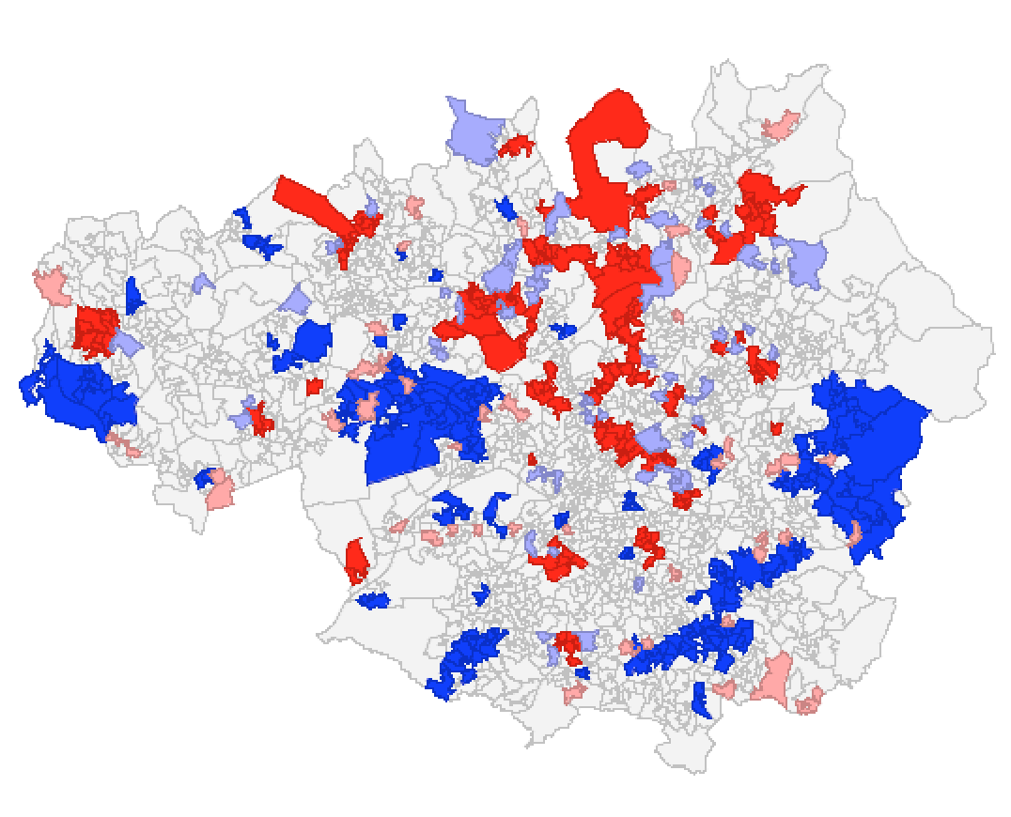
Course Outline
Intro
RStudio – Map Making Recap
Spatial Analysis (GeoDa & RStudio)
Spatial Autocorrelation
Clustering, Regression
Decision Making (RStudio)
Buffers, Overlays
Spatial Joins
Toilets, fire alarm, breaks, presentation

Slide 5
Outline of the day
9:45 - 10:05am – Spatial data & EDA
10:05 - 10:45am – P.1 Recap RStudio Maps
10:45 - 11:15am – Spatial Analysis
11:15 - 12:30pm – P.2 Spatial Analysis GeoDa
12:30 - 1:30pm – Lunch
1:30 - 1:45pm – Spatial Decision Making
1:45 - 3:00pm – P.3 Buffers / Intersections
3:00 - 3:15pm – Tea/Coffee
3:15 - 4pm/4:30pm – P.4 Regression
Notes:
Practical 2 – Bring Your Own Data
<number>

Slide 6
Outline of the day
10:15am – 10:30am – Spatial data & EDA
10:30am – 11:00am – 1. Recap RStudio Maps
11:00am – 11:30am – Spatial Analysis
11:30am – 12:30pm – 2. Spatial Analysis GeoDa
12:30pm – 1:30pm – Lunch
1:30pm – 1:45pm – Spatial Decision Making
1:45pm – 3:00pm – 3. Buffers / Intersections
3:00pm – 3:15pm – Tea/Coffee
3:15pm – 4pm/4:30pm – 4. Regression
Notes:
Practical 2 – Bring Your Own Data
<number>

Slide 7
Exploratory Data Analysis
First, a step back:
Data Analysis that is Exploratory
No formal hypothesis testing
Playing with and exploring the data
Usually start with descriptive statistics
Mean, St Dev, etc.
Usually first step to develop formal hypothesis

Slide 8
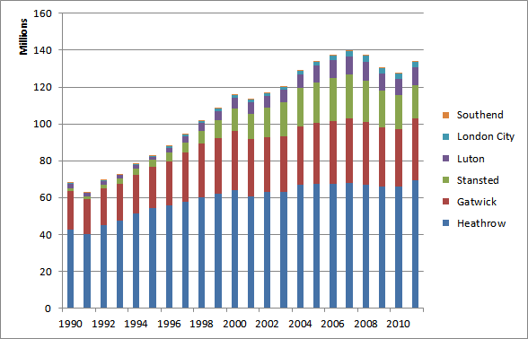
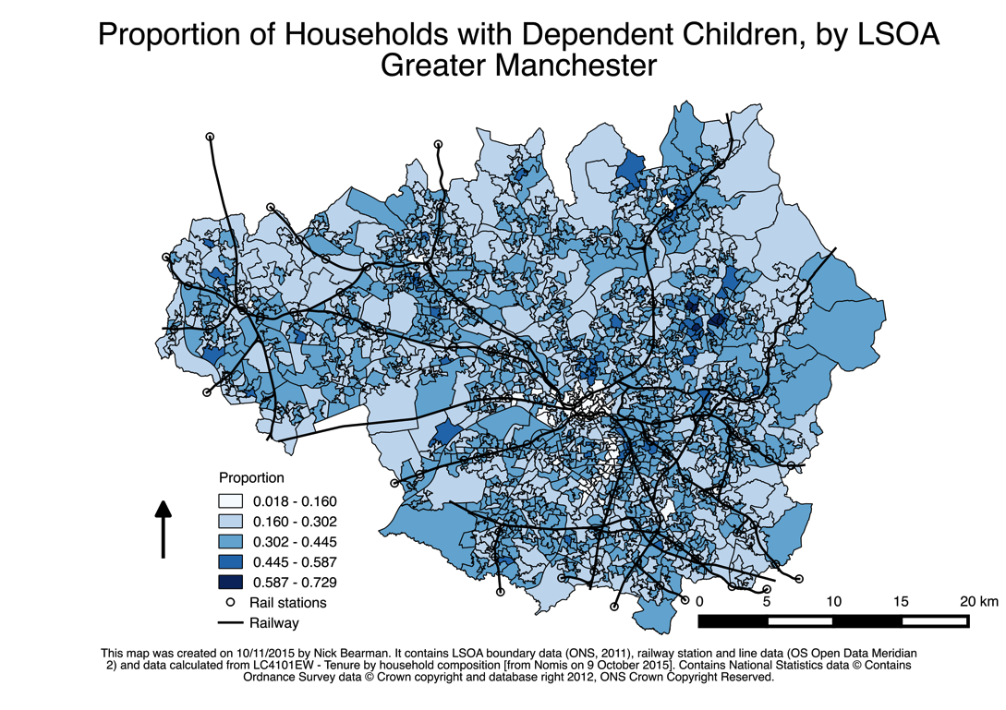
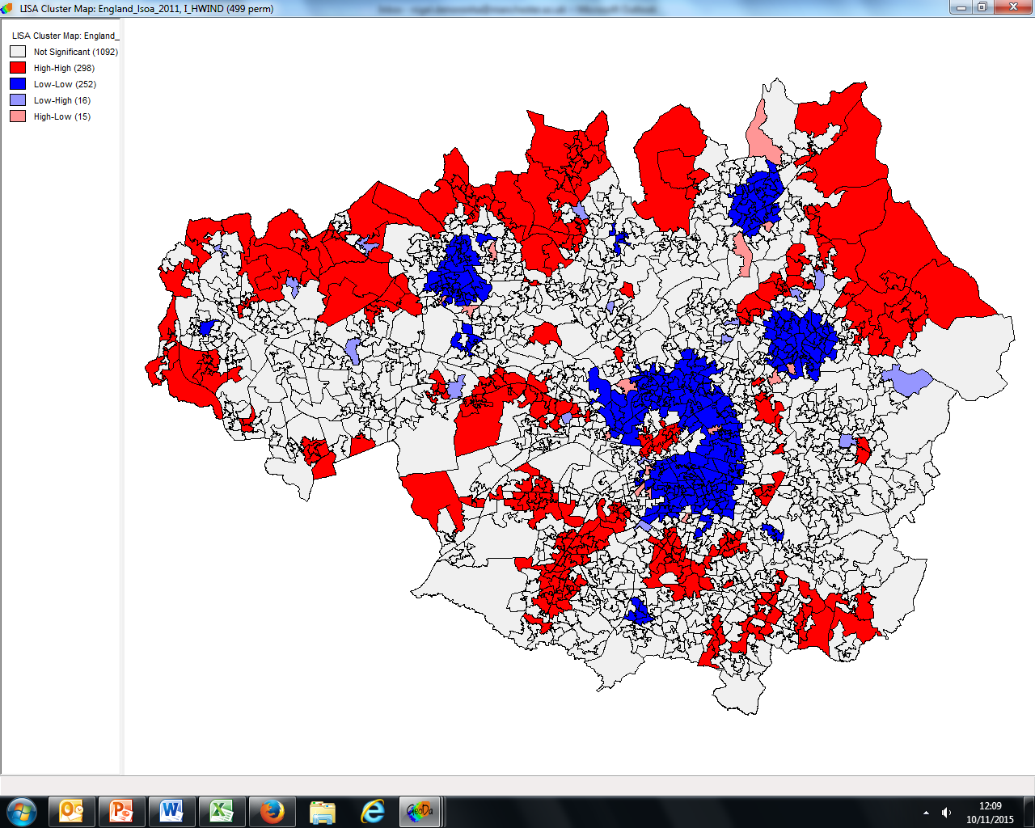
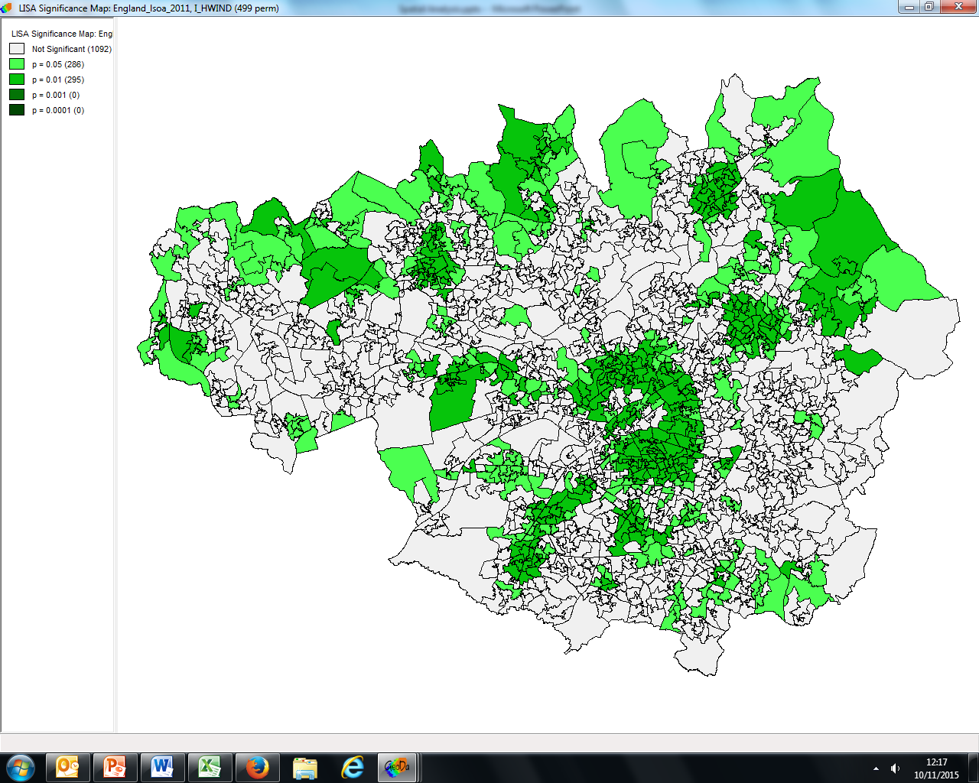
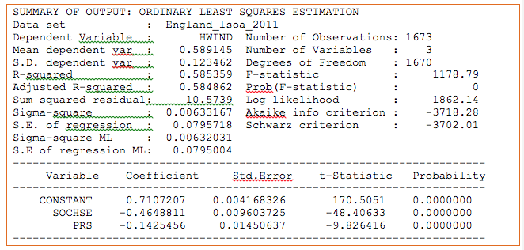
Three levels of data analysis
Numeric
Descriptive Maps
https://en.wikipedia.org/wiki/File:Passenger_numbers_for_London_Airports_in_a_bar_graph.png
Spatial Analytics
Notes:
Focus on 2 previously, 3 today.
<number>

Slide 9
Map Making & RStudio Recap
Previously / yesterday:
What is GIS / spatial data?
Why is selecting classes important?
Using RStudio
Read CSV / shapefiles
Manage data
Loops & Scripts
Libraries
(Spatial) Data Structure in R
Will do a quick recap of RStudio

Slide 10
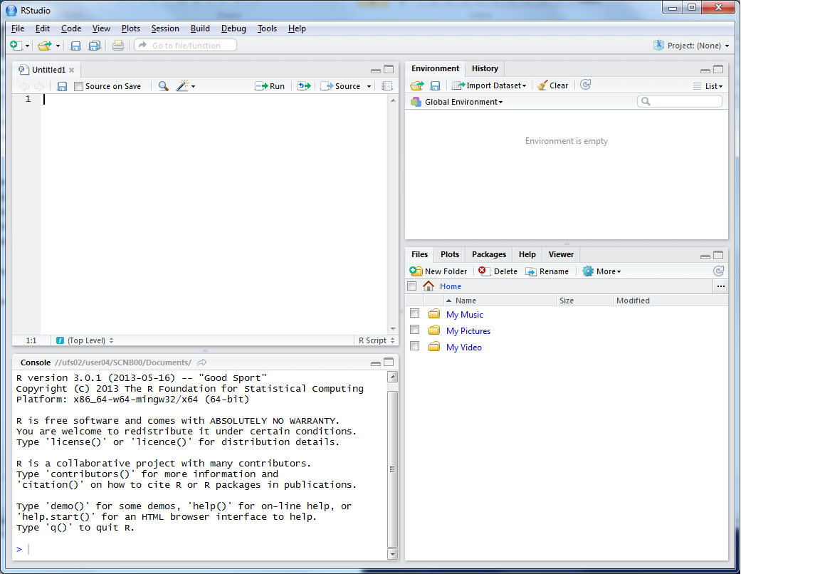


This is where you can write scripts
This lists the variables you have
Link to survey:
Here will show either your files (the files tab) or your plots (the plots tab)
This is the console where you can type in commands

Slide 11
RStudio Notes
Use a script
Highlight, Ctrl-Enter or click Run
Save your scripts
Add comments (#) to your script
Also use projects (if you wish)
Beware of typos
Tab completion

Slide 12
Data Structure – Slot Names
Variables of type Spatial*DataFrame
* = Points / Lines / Polygons
Slot Names slotNames(LSOA)
"data"
"polygons"
"bbox"
"proj4string"

Slide 13
Data Structure – Slot Names
Slot Names slotNames(LSOA)
"data” ”polygons” "bbox" "proj4string”
LSOA@data
LSOA@data$LSOA_CODE
@ and $
Try running
LSOA@proj4string

Slide 14
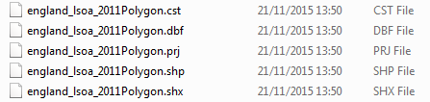
Shape Files
.shp the geometry (polygons) themselves
.shx extra geometry information
.dbf attribute information (dBase IV format)
.prj projection & coordinate system info
.cst text encoding
https://en.wikipedia.org/wiki/Shapefile
Notes:
Wikipedia can tell you more than you ever wanted to know about Shape file formats!
<number>

Slide 15
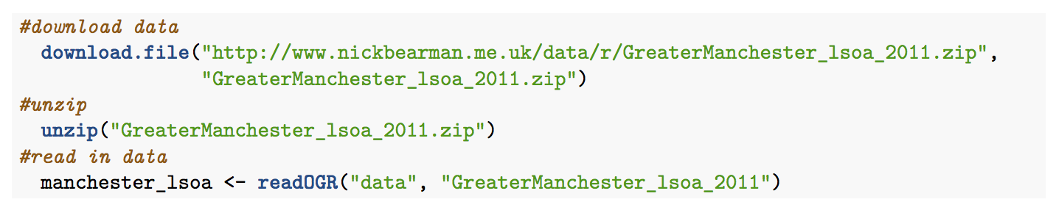
Some code wraps:
Above is an unfortunate file name – rename if you can. IMD.csv is much easier!

Slide 16
Practical 1 RStudio Map Making
Making Maps recap
Read spatial data & CSV in
Join data
Plot Map
Start a New Project
Write your code in a Script
Red and Green post-its

Slide 17
Outline of the day
9:45 - 10:05am – Spatial data & EDA
10:05 - 10:45am – P.1 RStudio Map Making
10:45 - 11:15am – Spatial Analysis
11:15 - 12:30pm – P.2 Spatial Analysis
12:30 - 1:30pm – Lunch
1:30 - 1:45pm – Spatial Decision Making
1:45 - 3:00pm – P.3 Buffers / Intersections
3:00 - 3:15pm – Tea/Coffee
3:15 - 4pm/4:30pm – P.4 Regression
Notes:
Practical 2 – Bring Your Own Data
<number>

Slide 18
Outline of the day
10:15am – 10:30am – Spatial data & EDA
10:30am – 11:00am – 1. Recap RStudio Maps
11:00am – 11:30am – Spatial Analysis
11:30am – 12:30pm – 2. Spatial Analysis GeoDa
12:30pm – 1:30pm – Lunch
1:30pm – 1:45pm – Spatial Decision Making
1:45pm – 3:00pm – 3. Buffers / Intersections
3:00pm – 3:15pm – Tea/Coffee
3:15pm – 4pm/4:30pm – 4. Regression
Notes:
Practical 2 – Bring Your Own Data
<number>

Slide 19
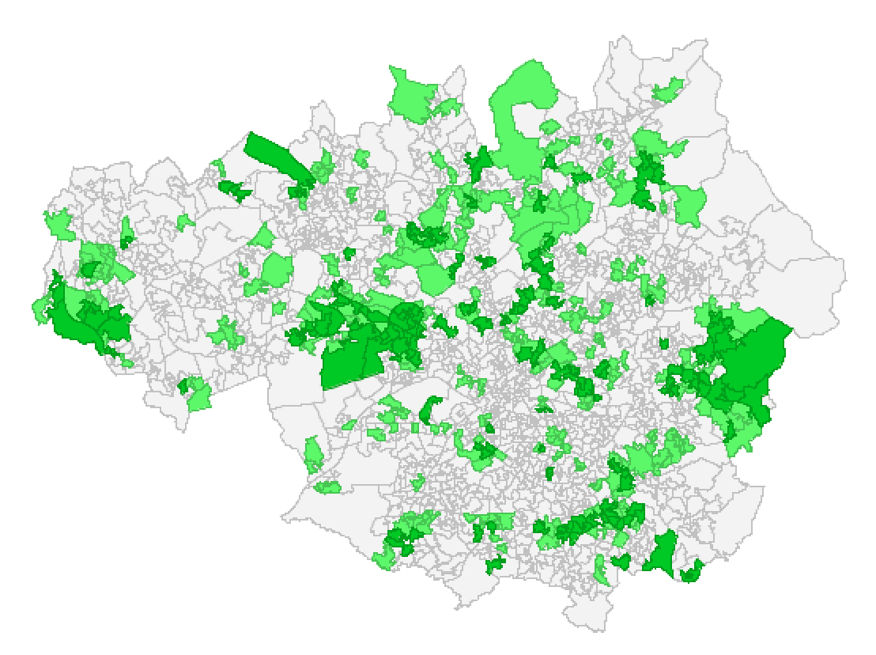
Spatial Analysis
Why are we interested in space?
Where things are have an impact
Sometimes just because of space and what they are next to
More often, because of some other variable that varies over space
Spatial Data
Many Advantages
Also Limitations

Slide 20
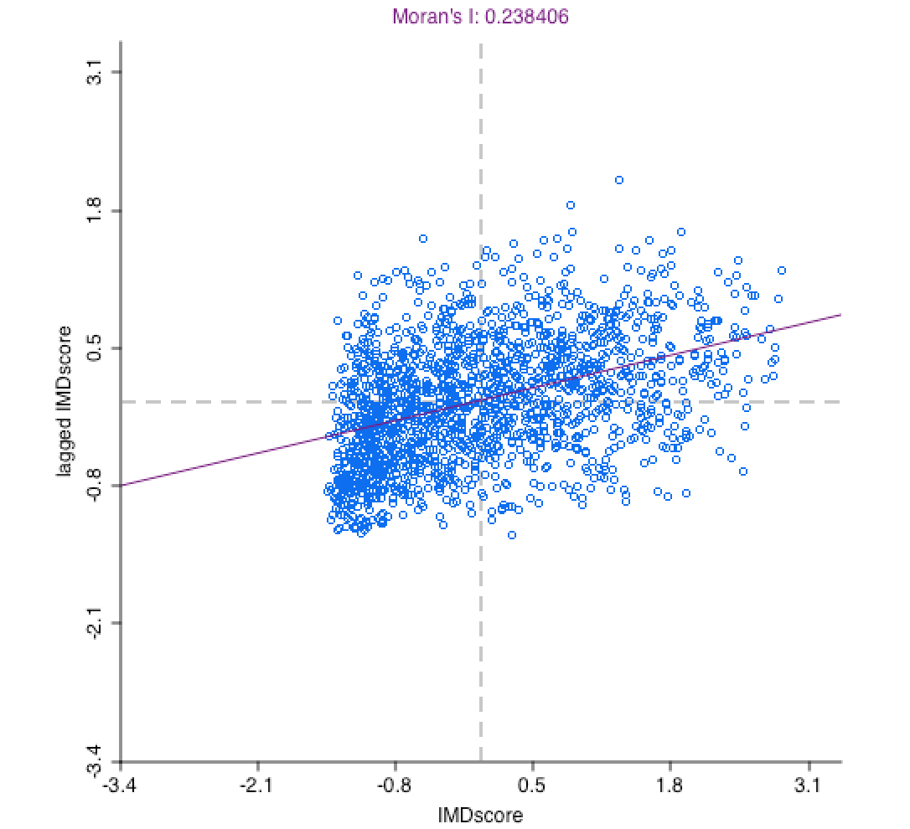
Challenges
Geocoding: locating individuals and events
Modifiable Areal Unit Problem
Spatial Dependence / Spatial Heterogeneity
Solutions
Diagnosing spatial autocorrelation
Global and local indicators
Mapping
Spatial regression techniques

Slide 21
Locating individuals and events
Location depends on research question and the availability of data
place of living or work?
geographic area of daily / yearly routines?
long-term longitudinal perspective?
at higher scale (e.g. neighbourhood, local authority)
To protect privacy geographical scale is often limited

Slide 22
Modifiable areal unit problem
“a problem arising from the imposition of artificial units of spatial reporting on continuous geographical phenomenon resulting in the generation of artificial spatial patterns” (Heywood, 1998)
“States and other forms of socio-political organization […] exercise their power in part through the ability to draw and redraw boundaries inside and around their territories” (Agnew, 2005)
Where (you) draw the boundaries is important
MPs in row over new seats set to push the boundaries
http://www.bbc.co.uk/news/uk-england-34701595
Gerrymandering (US) / How to Lie with Maps

Slide 23
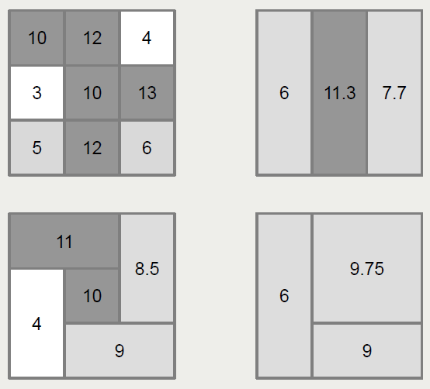
… an example …

Slide 24
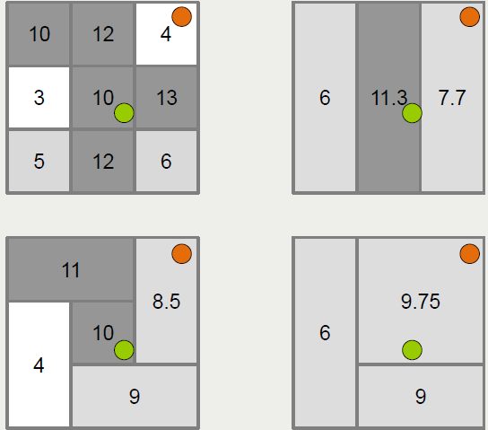
… and the potential for error

Slide 25
Ecological & individualistic fallacy
An ecological fallacy or ecological inference fallacy, is an error in the interpretation of statistical data in a study with macro data, whereby inferences about the nature of specific individuals are based solely upon aggregate statistics collected for the group to which those individuals belong.
Assuming every individual in the group has the group characteristics (e.g. IMD)
An individualistic fallacy or individualistic inference fallacy, is an error in the interpretation of statistical data in a study with micro data, whereby inferences about the nature of specific individuals are based solely upon individual statistics, not taking influences by the upper hierarchy contexts into account.
Assume everyone is individual, and no one is impacted by the group characteristics (e.g. IMD impacts)

Slide 26
Concepts of Spatial Dependence and Spatial Heterogeneity in Empirical Research
Spatial Dependence (2nd order spatial process)
Anselin (1988): “the existence of a functional relationship between what happens at one point in space and what happens elsewhere.“
Spatial Heterogeneity (1st order spatial process)
Not generated by spatial interaction. It refers to variation in relationships over space caused by the uniqueness of location or by spatially autocorrelated omitted variables].

Slide 27
Spatial dependence example
Prevalence of burglary
Income per household
1 | 2 | 3 | 4
5 | 6 | 7 | 8
9 | 10 | 11 | 12
13 | 14 | 15 | 16
1 | 2 | 3 | 4
5 | 6 | 7 | 8
9 | 10 | 11 | 12
13 | 14 | 15 | 16
low
medium
high
low
medium
high
Notes:
Spatial dependence – impact and relationship of space
<number>

Slide 28
Spatial heterogeneity example
Fertility levels
Female labour force participation
1 | 2 | 3 | 4
5 | 6 | 7 | 8
9 | 10 | 11 | 12
13 | 14 | 15 | 16
1 | 2 | 3 | 4
5 | 6 | 7 | 8
9 | 10 | 11 | 12
13 | 14 | 15 | 16
low
medium
high
low
medium
high
Notes:
Variation not caused by space, but by another variable (income)
<number>

Slide 29
Spatial autocorrelation
Spatial Autocorrelation can be
positive: clustering of high or low values
negative: clustering of neighbours with high and low values (chessboard pattern)
Effect of Spatial Autocorrelation in the error term is twofold:
it makes OLS-estimates of the t-test values unreliable
Positive Spatial Autocorrelation inflates the value of the r²-statistic, negative Spatial Autocorrelation deflates it.

Slide 30
Defining neighbours
To decide whether there is a spatial effect we need to calculate a neighbourhood weight. This can be base on:
Contiguity (adjacent spatial units)
Distance (between centroids of polygons)
Limited number of nearest neighbours
For the examples today we are using measures of contiguity.
Notes:
This is the weights file we have to create.
<number>

Slide 31
Contiguity measures
First order rook
First order queen
1 | 2 | 3 | 4
5 | 6 | 7 | 8
9 | 10 | 11 | 12
13 | 14 | 15 | 16
1 | 2 | 3 | 4
5 | 6 | 7 | 8
9 | 10 | 11 | 12
13 | 14 | 15 | 16

Slide 32
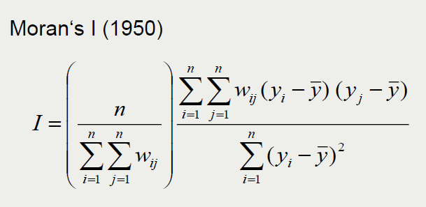
Global measure of spatial autocorrelation
Returns values of
1
Positive
0
None
-1
Negative
Spatial autocorrelation

Slide 33
Scatter plot of spatial autocorrelation
IMD in Greater Manchester

Slide 34

Clustering
Can look for unusual clusters
Where values are higher (or lower) than expected
Use univariate LISA:
To identify statistically significant clusters
Local Indicators of Spatial Autocorrelation
(Anselin, 1995)
Notes:
Image http://cdn3.hark.com/images/000/002/631/2631/original.gif
http://www.hark.com/collections/dtqzfmzlvm-lisa-simpson
<number>

Slide 35
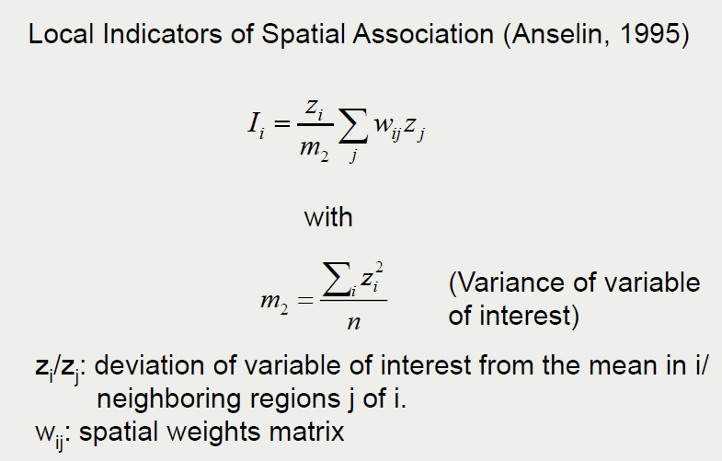
Local measures of spatial autocorrelation

Slide 36
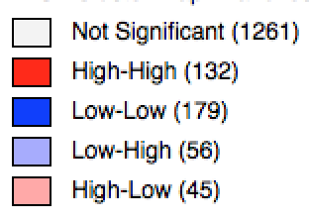
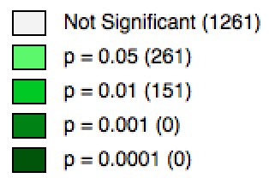
Local indicators of spatial autocorrelation (LISA maps)
IMD Score in Greater Manchester
White not significant
Red High surrounded by High
Blue Low surrounded by Low
Light blue Low surrounded by High
Pink High surrounded by Low
Notes:
High score = most deprived
Low score = least deprived
<number>

Slide 37
… and finally what might explain this
Geoda provides a regression model which allows you to take account of spatial lag (the effect of neighbouring areas) or spatial error (spatial heterogeneity)
It is best to try and fit a standard regression first so that you can compare the model fit criteria
In the practical exercise we will explore these options further

Slide 38
Regression
Instructions in GeoDa and R
Predicting ‘Hardworking neighbourhoods’
(employed full time population / total pop.)
Some variables are more useful than others
Some correlate so we need to exclude them

Slide 39
Practical 2 Performing Spatial Analysis
Using GeoDa & R for some analysis
Please experiment as we go through
Break at 12:30pm
Carry on with Practical 3 if you finish 2
I will do presentation after lunch

Slide 40
Lunch

Slide 41
Outline of the day
10:15am – 10:30am – Spatial data & EDA
10:30am – 11:00am – 1. Recap RStudio Maps
11:00am – 11:30am – Spatial Analysis
11:30am – 12:30pm – 2. Spatial Analysis GeoDa
12:30pm – 1:30pm – Lunch
1:30pm – 1:45pm – Spatial Decision Making
1:45pm – 3:00pm – 3. Buffers / Intersections
3:00pm – 3:15pm – Tea/Coffee
3:15pm – 4pm/4:30pm – 4. Regression
Notes:
Practical 2 – Bring Your Own Data
<number>

Slide 42
Outline of the day
9:45 - 10:05am – Spatial data & EDA
10:05 - 10:45am – P.1 RStudio Map Making
10:45 - 11:15am – Spatial Analysis
11:15 - 12:30pm – P.2 Spatial Analysis
12:30 - 1:30pm – Lunch
1:30 - 1:45pm – Spatial Decision Making
1:45 - 3:00pm – P.3 Buffers / Intersections
3:00 - 3:15pm – Tea/Coffee
3:15 - 4pm/4:30pm – P.4 Regression
Notes:
Practical 2 – Bring Your Own Data
<number>

Slide 43
Spatial Decision Making
Using GIS to help us make a decision from a number of available options
Wide range of applications:
Where to site a paint factory?
Where can we site some wind turbines?
Which areas would benefit most from public transport?
Which areas find it hard to access a GP?
etc.

Slide 44
Spatial Decision Making
GIS allows us to answer (some) of these questions
But remember
CICO / Crap In -> Crap Out
Analysis is only as good as your data
And won’t provide all the answers

Slide 45
Getting Data In
Getting spatial data in is one of the key elements of any GIS analysis
Joining (Attribute & Spatial)
Linked Data

Slide 46
Attribute Join
Area ID
1
2
3
4
5
14
7
8
11
Area ID | Deprivation
1 | High
2 | High
3 | High
4 | Average
5 | Average
6 | Average
7 | Low
8 | Low
9 | Low
10 | High
11 | Low
12 | High
13 | High
14 | Average
15 | Average
1
2
3
14
4
7
5
8
11
Data
Polygons
Lookup

Slide 47
Attribute Join
5
15
30
County | Course Participants
Cornwall | 30
Devon | 5
Somerset | 15
County
Cornwall
Devon
Somerset
County | Population
Cornwall | 536,000
Devon | 1,100,000
Somerset | 529,000

Slide 48
Attribute Join
Name | Address | Postcode
J Smith | 1 The Street | TR1 1DE
M Jones | 23 High Street | PL6 7TH
N Coles | 34 Falmouth Road | L17 9QA
Postcode | Coordinate
TR1 1DE | 345000 450000
PL6 7TH | 645000 650000
L17 9QA | 845000 750000
5
15
30

Slide 49
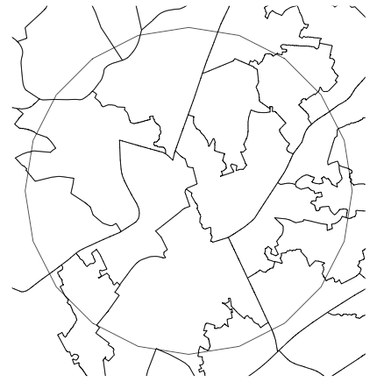
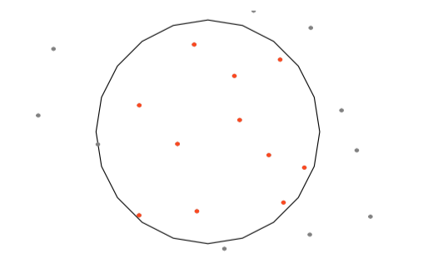
Spatial Join - Point in Polygon
Notes:
Points (LSOAs) within Tram station buffers
<number>

Slide 50
Linked Data
Usually Attribute Joins
Name > Postcode
Name > Address > Postcode
Name > Address > Postcode > IMD deprivation
Name | Address | Postcode
J Smith | 1 The Street | TR1 1DE
M Jones | 23 High Street | PL6 7TH
N Coles | 34 Falmouth Road | L17 9QA
Postcode | Coordinate
TR1 1DE | 345000 450000
PL6 7TH | 645000 650000
L17 9QA | 845000 750000

Slide 51
Linked Data
Name | Address | Medical Data | IMD
Confidential data
Perhaps only interested in medial data and IMD
But need to go through Name and Address

Slide 52
Name | Address | Postcode
J Smith | 1 The Street | TR1 1DE
M Jones | 23 High Street | PL6 7TH
N Coles | 34 Falmouth Road | L17 9QA
Postcode | IMD
TR1 1DE | 2.33
PL6 7TH | 1.33
L17 9QA | 5.33
Name | Medical
J Smith | Heart Disease
M Jones | Stroke
N Coles | Tooth Ache
Postcode | Coordinate
TR1 1DE | 345000 450000
PL6 7TH | 645000 650000
L17 9QA | 845000 750000

Slide 53
Name | Address | Postcode
J Smith | 1 The Street | TR1 1DE
M Jones | 23 High Street | PL6 7TH
N Coles | 34 Falmouth Road | L17 9QA
Postcode | Coordinate
TR1 1DE | 345000 450000
PL6 7TH | 645000 650000
L17 9QA | 845000 750000
Name | Medical
J Smith | Heart Disease
M Jones | Stroke
N Coles | Tooth Ache
Shapefile | IMD
 | 2.33
 | 1.33
 | 5.33
Medical | IMD (Average)
Heart Disease | 3.44
Stroke | 6.55
Tooth Ache | 2.33

Slide 54
Linked Data
A mix of attribute and spatial joins
Common in linked data
Medical | IMD (Average)
Heart Disease | 3.44
Stroke | 6.55
Tooth Ache | 2.33

Slide 55


Linked Data
A mix of attribute and spatial joins
Common in linked data
An aside – Two types of “Linked Data”
Joined Data
Semantic web
Medical | IMD (Average)
Heart Disease | 3.44
Stroke | 6.55
Tooth Ache | 2.33
http://data.ordnancesurvey.co.uk/

Slide 56

Getting Data In
Getting spatial data in is one of the key elements of any GIS analysis
Joining (Attribute & Spatial)
Linked Data
Once you have the data in, we need to do something with it
Answering the question

Slide 57
Deprivation & Transport
(Affordable) public transport can help with deprivation
The benefits of providing new public transport in deprived areas
https://www.jrf.org.uk/report/benefits-providing-new-public-transport-deprived-areas
Transport and Poverty: A Review of the Evidence
https://www.ucl.ac.uk/transport-institute/pdfs/transport-poverty

Slide 58
Deprivation & Transport
We will be looking at Metrolink tram in Greater Manchester
But principles can easily be applied to any other data
As you go through the practical:
How might these concepts be applied to your data?
What other spatial analysis techniques might be useful?

Slide 59
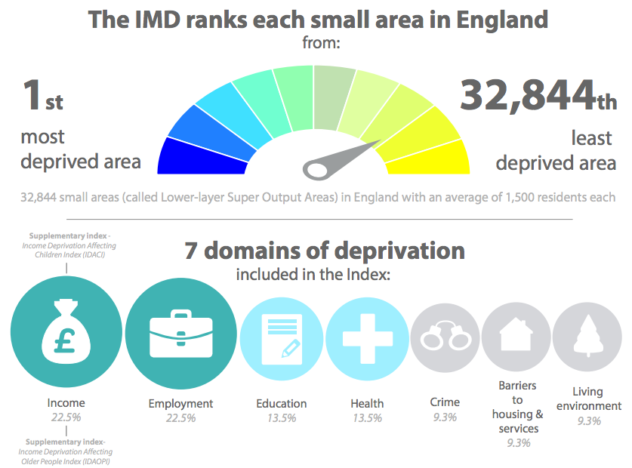
IMD – Index of Multiple Deprivation
Highest score
Lowest score
https://www.gov.uk/government/statistics/english-indices-of-deprivation-2015
Notes:
<number>

Slide 60
Spatial Decision Making
We will be using
Point in Polygon
Buffers
Overlay & Averages

Slide 61


Buffers
Notes:
Buffers around tram stations
<number>

Slide 62

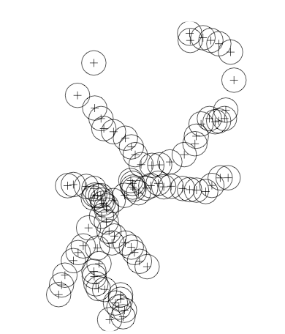
Buffers

Slide 63
Point in Polygon
Converting LSOA polygons to points
Notes:
Points (LSOAs) within Tram station buffers
<number>

Slide 64
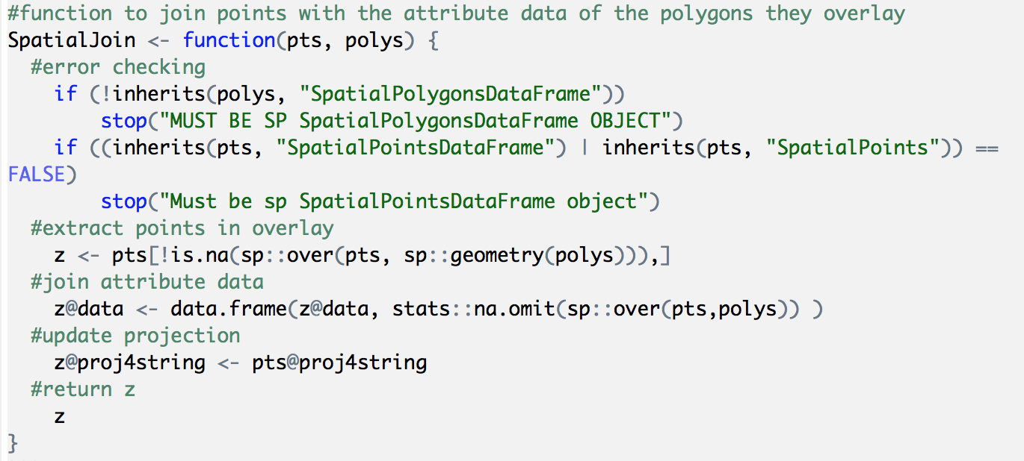
Functions
Make code easier to use
Have used many already
Any code can be made a function (maps)
Notes:
Key aspect to remember is inputs and outputs
<number>

Slide 65
File Formats
Currently been using Shapefiles
They are just one of many formats
Tram line data is in GeoJSON:
Open in Notepad if you are interested
Notes:
Key aspect to remember is inputs and outputs
<number>

Slide 66
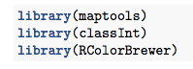
Practical 3 Buffers and Intersections
Load Libraries
Working directory
Tab completion
Things to think about:
What is easier / harder in RStudio compared to other software?
What other data could we use?
How else could we do the analysis?

Slide 67
Tea / Coffee

Slide 68
Outline of the day
9:45 - 10:05am – Spatial data & EDA
10:05 - 10:45am – P.1 RStudio Map Making
10:45 - 11:15am – Spatial Analysis
11:15 - 12:30pm – P.2 Spatial Analysis
12:30 - 1:30pm – Lunch
1:30 - 1:45pm – Spatial Decision Making
1:45 - 3:00pm – P.3 Buffers / Intersections
3:00 - 3:15pm – Tea/Coffee
3:15 - 4pm/4:30pm – P.4 Regression
Notes:
Practical 2 – Bring Your Own Data
<number>

Slide 69
Outline of the day
10:15am – 10:30am – Spatial data & EDA
10:30am – 11:00am – 1. Recap RStudio Maps
11:00am – 11:30am – Spatial Analysis
11:30am – 12:30pm – 2. Spatial Analysis GeoDa
12:30pm – 1:30pm – Lunch
1:30pm – 1:45pm – Spatial Decision Making
1:45pm – 3:00pm – 3. Buffers / Intersections
3:00pm – 3:15pm – Tea/Coffee
3:15pm – 4pm/4:30pm – 4. Regression
Notes:
Practical 2 – Bring Your Own Data
<number>

Slide 70
Practical 4: Regression
Brief overview of Regression in GeoDa & R
Feel free to experiment
Or try some of the techniques we’ve discussed on your own data
Feedback is really important for me

Slide 71
What have you got from the course?
Using a range of GIS software to perform a range of spatial analysis
RStudio and GeoDa
Develop your confidence in using RStudio
Data handling
Scripts
Functions

Slide 72
Course Outline
Spatial Analysis & Decision Making
Spatial Autocorrelation
Clustering, Regression
RStudio
Buffers
Overlays
GeoDa
Spatial Autocorrelation / Clustering

Slide 73

Pros and Cons - R
+ scriptable
+ easily repeatable (change buffer)
+ custom analysis (& functions)
- steeper learning curve
- analysis gets very complex very quickly (poly in poly overlay)

Slide 74

References
Agnew, (2005) Sovereignty regimes: Territoriality and state authority in contemporary world politics, Annals of the Association of American Geographers, 437-461
Anselin, (1988) Spatial Econometrics: Methods and Models, vol.4. Studies in Operational Regional Science. Dordrecht: Springer Netherlands. http://link.springer.com/10.1007/978-94-015-7799-1
Anselin, L. (1995). Local Indicators of Spatial Association - LISA. Geographical Analysis 27, 93–115.
Brunsdon, C. & Comber L. (2015) An Introduction to R for Spatial Analysis and Mapping, Sage Publishing
Heywood (1998) Introduction to Geographical Information Systems. New York: Addison Wesley Longman.

Slide 75
Practical
Feedback is really important for me
Or email / phone / in person

